Slide 1

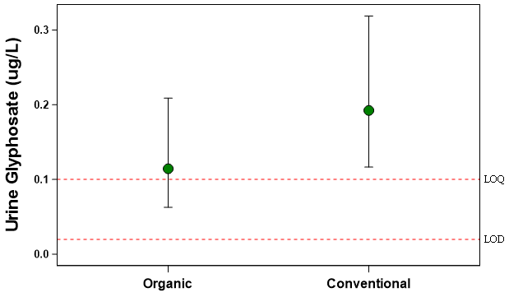
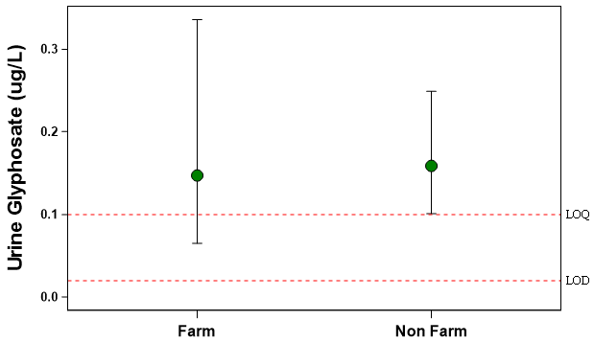
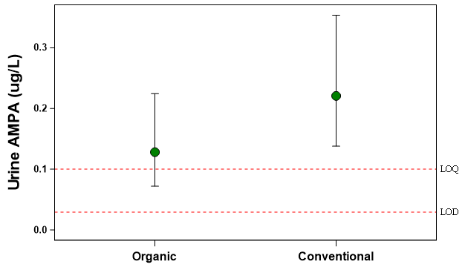
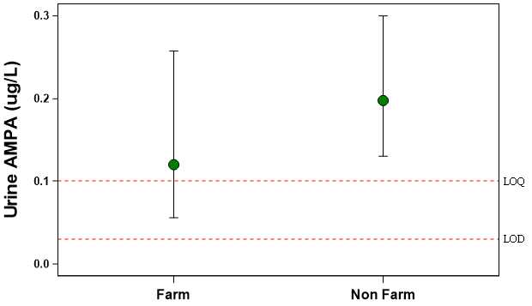
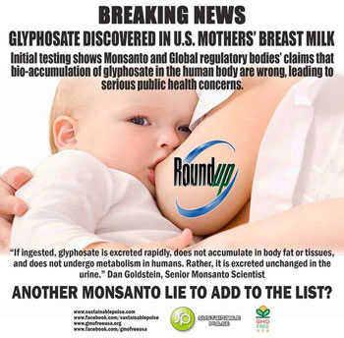



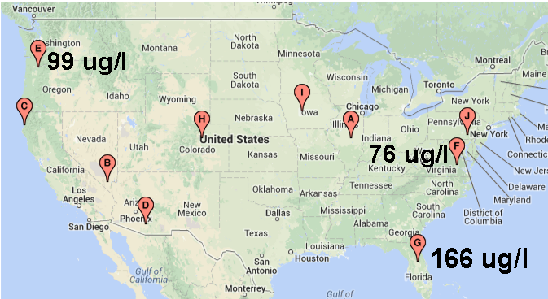


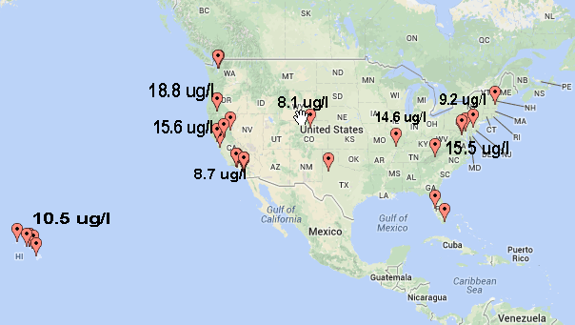

Evidence that glyphosate, the active ingredient in Roundup®, is not present in human milk Michelle K McGuire, Kimberly Lackey, Janae Carrothers, Bahman Shafii, William Price, and Mark A McGuire
School of Biological Sciences and Paul G. Allen School for Global Animal Health, Washington State University, Pullman, WA, USA; Statistical Programs, College of Agricultural and Life Sciences, University of Idaho, Moscow, ID, USA; Department of Animal and Veterinary Science, University of Idaho, Moscow, ID, USA
Abstract
Subjects and Methods
Results, cont.
Glyphosate [N-(phosphonomethyl) glycine], the active ingredient in Roundup®, is used to control broadleaf weeds and grasses in row crops, ornamental plants, lawns, and forest plantings. Despite publication of numerous studies showing that use of glyphosate as directed poses no risk to humans, there continues to be public concern. Recently, an on-line publication of a small survey conducted by an advocacy group claimed that 3 out of 10 human milk samples they tested had “high” levels of glyphosate (76-166 µg/mL), and some urine samples contained glyphosate levels 10-times higher than those found in Europe. This non-peer-reviewed publication has generated some attention and concern. However, the ELISA-based assay used in this study was neither validated nor optimized for human milk, a complex biological matrix notoriously difficult to accurately analyze. In response, after receiving Institutional Review Board approval and consent from subjects, we collected milk and urine samples from 41 healthy lactating women living in the Moscow, ID-Pullman, WA area – a highly-productive agricultural region of the US Pacific Northwest where glyphosate is used routinely in farming practices. Questionnaires documenting potential glyphosate exposure from the environment, activities, and foods were also completed. Milk and urine samples were analyzed for glyphosate and aminomethylphosphonic acid (AMPA, a glyphosate metabolite) using highly sensitive LC-MS/MS methods validated for and optimized to each sample matrix. Limits of detection (LOD) and quantification (LOQ) for glyphosate in milk were 2.0 and 10.0 µg/L, respectively; those for urine were 0.02 and 0.10 µg/L, respectively. LOD and LOQ for AMPA in milk were 2.0 and 10.0 µg/L, respectively; those for urine were 0.03 and 0.10 µg/L, respectively. Ten of the women reported living on or directly adjacent to a farm or ranch; 23 of the women described their personal diet as conventional; and 5 had personally mixed or applied glyphosate sometime in the past. Contrary to the advocacy group’s report, our assay detected neither glyphosate nor AMPA in any milk sample. Glyphosate concentrations of 8 and 3 of the urine samples were <LOD or <LOQ, respectively, with an average (± SEM) value of 0.30 ± 0.06 µg/L. For AMPA, 9 and 2 of the samples had concentrations <LOD or <LOQ, respectively, with an average value of 0.31 ± 0.05 µg/L. There was no relationship between whether a subject self-identified as consuming organic vs. conventionally-grown foods and her urinary glyphosate and AMPA levels, nor was there a difference between women who lived on or near a farm/ranch and those who lived in an urban or suburban non-farming area. In conclusion, our data – obtained using sophisticated and validated methods of analyses– strongly suggest that glyphosate does not bioaccumulate and is not present in human milk even when the mother has detectable glyphosate and/or AMPA in her urine. These findings emphasize the critical importance of carefully validating laboratory methods to the biological matrix of interest, especially when it is as complex as human milk.
Subjects (see Table 1)
41 healthy lactating women living in the Moscow, ID/Pullman, WA area
1-3 mo postpartum
Sample and data collection
Between 8:00-10:00 am
After cleaning breast, milk (not complete expression) collected into sterile containers using electric pump
Urine collected using clean-catch technique into sterile container
Samples immediately placed on ice, then frozen at -20 ⁰C until analysis
Questionnaire regarding possible environmental glyphosate exposure completed
Glyphosate and AMPA assay development and validation
LC-MS/MS assays developed and validated specifically for human milk and urine matrices (see Figures 2 and 3)
Limits of detection (LOD)
  Milk glyphosate: 1.0 µg/L
  Milk AMPA: 1.0 µg/L
  Urine glyphosate: 0.02 µg/L
  Urine AMPA: 0.03 µg/L
Limits of quantification (LOQ)
  Milk glyphosate: 10.0 µg/L
  Milk AMPA: 10.0 µg/L
  Urine glyphosate: 0.10 µg/L
  Urine AMPA: 0.10 µg/L
Statistical analyses conducted in SAS (version 9.4) using the GLIMMIX procedure
  To correct for skewness, a log-normal distribution was assumed.
  When appropriate, ½ LOD and ½ LOQ nominal values were used.²
Table 2 Milk and urine glyphosate and AMPA concentrations.
ID | Milk Glyphosate | Milk AMPA | Urine Glyphosate (µg/L) | Urine AMPA (µg/L)
1001 | <LOD | <LOD | <LOD | <0.10
1002 | <LOD | <LOD | 0.32 | 0.35
1003 | <LOD | <LOD | <LOD | <0.10
1004 | <LOD | <LOD | 0.13 | 0.60
1005 | <LOD | <LOD | 0.19 | 0.42
1006 | <LOD | <LOD | 0.39 | 0.11
1007 | <LOD | <LOD | 0.15 | 0.44
1008 | <LOD | <LOD | 1.06 | 1.27
1009 | <LOD | <LOD | 0.26 | 0.78
1010 | <LOD | <LOD | 0.16 | 0.14
1011 | <LOD | <LOD | 0.18 | 0.13
1012 | <LOD | <LOD | 0.30 | 0.69
1013 | <LOD | <LOD | 0.14 | <0.10
1014 | <LOD | <LOD | 0.16 | 1.09
1015 | <LOD | <LOD | <0.10 | <0.10
1016 | <LOD | <LOD | 0.90 | 0.43
1017 | <LOD | <LOD | 0.18 | <0.10
1018 | <LOD | <LOD | 1.25 | 1.33
1019 | <LOD | <LOD | <0.10 | <0.10
1020 | <LOD | <LOD | 0.45 | 0.12
1021 | <LOD | <LOD | 0.19 | 0.16
1022 | <LOD | <LOD | <0.10 | 0.10
1023 | <LOD | <LOD | <0.10 | <0.10
1024 | <LOD | <LOD | 0.24 | 0.27
1025 | <LOD | <LOD | 0.35 | 0.16
1026 | <LOD | <LOD | 0.24 | 0.20
1027 | <LOD | <LOD | 0.18 | 0.21
1028 | <LOD | <LOD | 0.15 | <0.10
1029 | <LOD | <LOD | 0.11 | 0.47
1030 | <LOD | <LOD | <0.10 | <0.10
1031 | <LOD | <LOD | <0.10 | 0.16
1032 | <LOD | <LOD | 0.30 | 0.11
1034 | <LOD | <LOD | 0.28 | 0.16
1035 | <LOD | <LOD | <LOD | <LOD
1036 | <LOD | <LOD | <0.10 | 0.22
1037 | <LOD | <LOD | 0.22 | 0.36
1038 | <LOD | <LOD | 1.93 | 0.55
1039 | <LOD | <LOD | <0.10 | <LOD
1040 | <LOD | <LOD | 0.34 | 0.31
1041 | <LOD | <LOD | 0.14 | 0.19
Table 3 Average milk and urine glyphosate and AMPA concentrations.
Variable | Mean ± SEM
Milk glyphosate (µg/L) | ≤ LOD
Milk AMPA (µg/L) | ≤ LOD
Urine glyphosate (µg/L) | 0.28 ± 0.06
Urine AMPA (µg/L) | 0.30 ± 0.05
Figure 4 Relationships between food preferences or location of residence and urine glyphosate concentration.
Background and Hypothesis
P = 0.14
P = 0.88
Glyphosate [N-(phosphonomethyl) glycine], the active ingredient in Roundup®, is used to control broadleaf weeds and grasses. An on-line publication of a small survey conducted by Moms Across America and Sustainable Pulse claimed that 3 out of 10 human milk samples tested had “high” levels of glyphosate, and some urine samples contained “very high” levels (Figure 1).¹ These findings, which have led to public concern about the safety of glyphosate (see below) are not consistent with published safety data, and information about the validity of the assays (which were ELISA-based and validated for water) was not provided. We hypothesized that use of more sophisticated assays to quantify glyphosate and aminomethylphosphonic acid (AMPA, a glyphosate metabolite) in human milk and urine would either not detect or yield very low concentrations of these compounds in these biological fluids.
Figure 5 Relationships between food preferences or location of residence and urine AMPA concentration.
P = 0.14
P = 0.25
Adjusting for covariates (age, time postpartum, BMI, parity) did not alter these conclusions.
Figure 1 Examples of selected public repercussions related to on-line “publication” by Moms Across America and Sustainable Pulse claiming detection of glyphosate in human milk and urine.
Figure 2 Example chromatograms for glyphosate.
Figure 3 Example chromatograms for AMPA.
Urine
Urine
Conclusions
Glyphosate and AMPA are not present in human milk even when the mother has detectable glyphosate and/or AMPA in her urine.
Urine glyphosate and AMPA concentrations in lactating women are below detection or extremely low and not of concern.
These results provide additional evidence that glyphosate does not bioaccumulate in the human body.
These findings emphasize the critical importance of carefully validating laboratory methods to the analyte in the biological matrix of interest, especially when it is as complex as human milk.
Milk
Milk
http://seattleorganicrestaurants.com
http://naturalsociety.com
Milk glyphosate
Results
Disclosure
https://desdaughter.wordpress.com
Table 1 Characteristics of women (n = 41) in study.
Variable | Mean ± SEM or #
Age (y) | 29 ± 0.8
Time postpartum (mo) | 2.2 ± 0.1
Parity (#) | 1.8 ± 0.2
Body mass index (kg/m²) | 30.2 ± 3.4
Lived on or near a farm/ranch | 10 (25%)
Strictly or mainly “organic” food choices | 17 (42%)
Had personally mixed herbicide | 6 (15%)
The assays for milk and urine glyphosate and AMPA used in this study were developed and validated by chemists at Monsanto, the producer of Roundup®. Analyses of the milk samples were conducted both in the Monsanto laboratories (St. Louis, MO) and independently at Covance Laboratories, Inc. (Madison, WI).
www.facebook.com/MomsAcrossAmerica
References
Urine glyphosate
Moms Across America and Sustainable Pulse. Glyphosate testing report: Findings in American Mothers’ Breast milk, Urine and Water. April 7, 2014. Available at www.momsacrossamerica.com/glyphosate_testing_results.
Office of Pesticide Programs, US Environmental Protection Agency. Assigning value to non-detected/non-quantified pesticide residues in human health food exposure assessments. March 23, 2000. Available at www.epa.gov/oppfead1/trac/science/trac3b012.pdf.
www.momsacrossamerica.com
http://articles.mercola.com

